Slide 1

Geometry
Unit 1, Lesson 4 Dilations and Partitions Volume 1, pg. 20

Slide 2


Benchmarks
MA.912.GR.1.1
Prove relationships and theorems about lines and angles. Solve mathematical and real-world problems involving postulates, relationships, and theorems of lines and angles.
MA.912.GR.2.2
Identify transformations that do or do not preserve distance.
volume 1, pg. 20

Slide 3
Integrated Mathematical Thinking and Reasoning Standards
MA.K12.MTR.1.1 Actively participate in effortful learning both individually and collectively.
MA.K12.MTR.2.1 Demonstrate understanding by representing problems in multiple ways.
MA.K12.MTR.4.1 Engage in discussions that reflect on the mathematical thinking of self and others.
MA.K12.MTR.5.1 Use patterns and structure to help understand and connect mathematical concepts.
volume 1, pg. 20

Slide 4

Learning Targets
I can dilate a line segment.
I can define midpoint using dilation and understand partitions.
I can relate scale factor to dilation.
volume 1, pg. 20

Slide 5

Warm-Up
volume 1, pg. 20

Slide 6
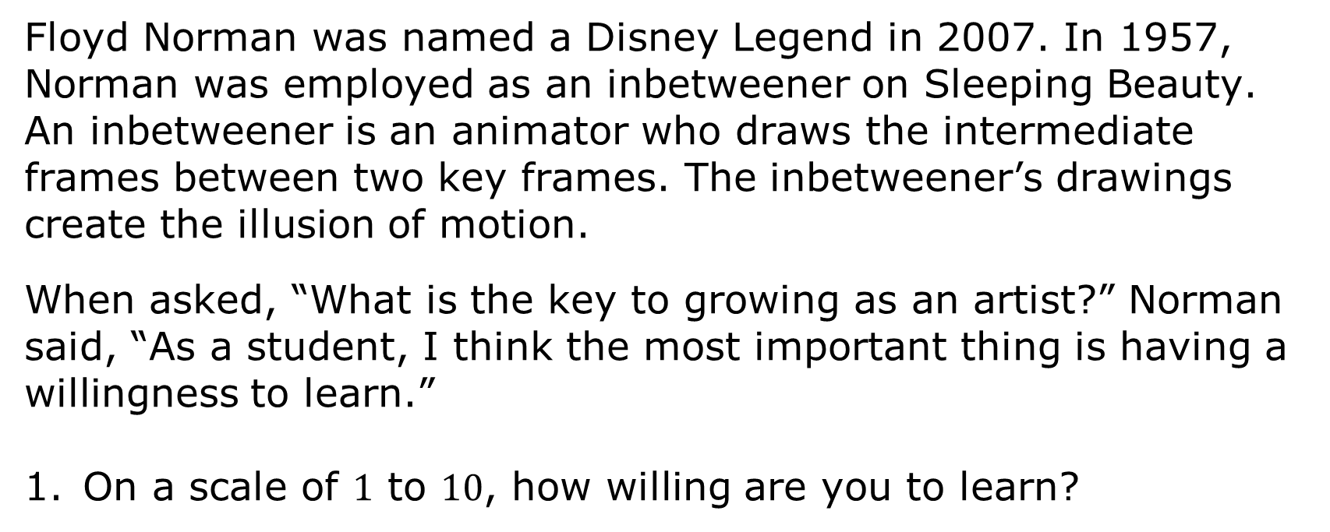
1.4.1 Warm-Up: Floyd Norman
Floyd Norman was named a Disney Legend in 2007. In 1957, Norman was employed as an inbetweener on Sleeping Beauty. An inbetweener is an animator who draws the intermediate frames between two key frames. The inbetweener’s drawings create the illusion of motion.
When asked, “What is the key to growing as an artist?” Norman said, “As a student, I think the most important thing is having a willingness to learn.”
On a scale of $1$ to $10$, how willing are you to learn?
volume 1, pg. 20

Slide 7
When asked about his career Norman stated, “Making mistakes is how we grow, how we learn.” He said he had no confidence, but at least he made the first step.
Describe a time in your life when you had no confidence, but you made the first step and learned from making mistakes.
Norman described a time when Walt Disney asked him to write. Norman made these two statements as he reflected on doing something he did not think he could do.
“The only obstacle you face is yourself.”
“If you are willing to do the work, make that commitment, then I don’t believe there is an obstacle.”
What subject(s) are obstacles for you?
volume 1, pg. 21

Slide 8

Exploration
volume 1, pg. 21

Slide 9

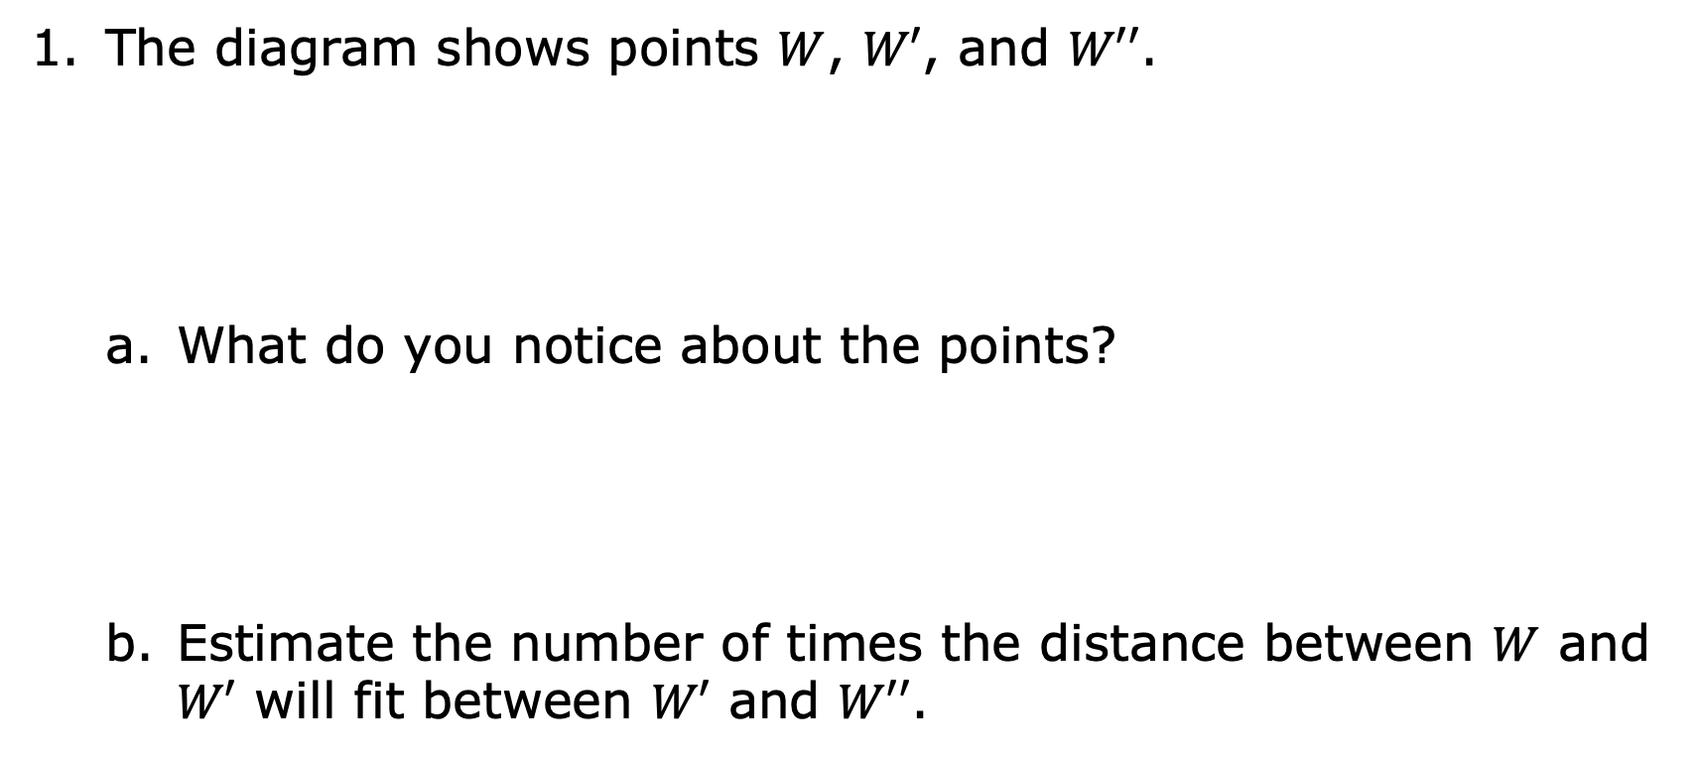



1.4.2 Exploration: Dilating a Line Segment
The diagram shows points $W$, $W′$, and $W′′$.
What do you notice about the points?
Estimate the number of times the distance between $W$ and $W′$ will fit between $W′$ and $W′′$.
$$W$$
$$W′$$
$$W′′$$
volume 1, pg. 21

Slide 10
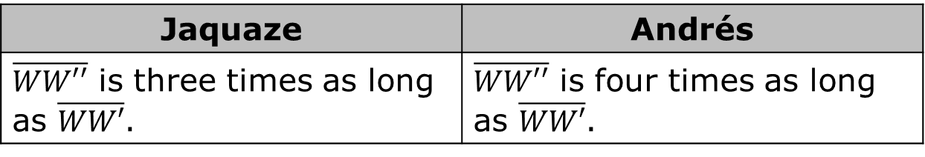
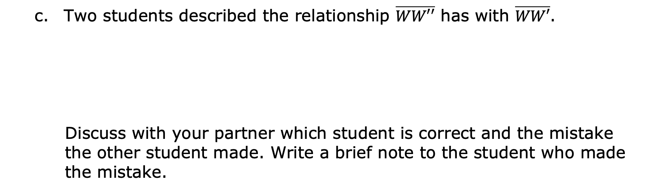
Two students described the relationship $\overline{WW′′}$ has with $\overline{WW′}$.
Discuss with your partner which student is correct and the mistake the other student made. Write a brief note to the student who made the mistake.
Jaquaze | Andrés
$\overline{WW′′}$ is three times as long as $\overline{WW′}$. | $\overline{WW′′}$ is four times as long as $\overline{WW′}$.
Means
I
Start
To
Acquire
Knowledge
Experience
Skills
volume 1, pg. 22

Slide 11
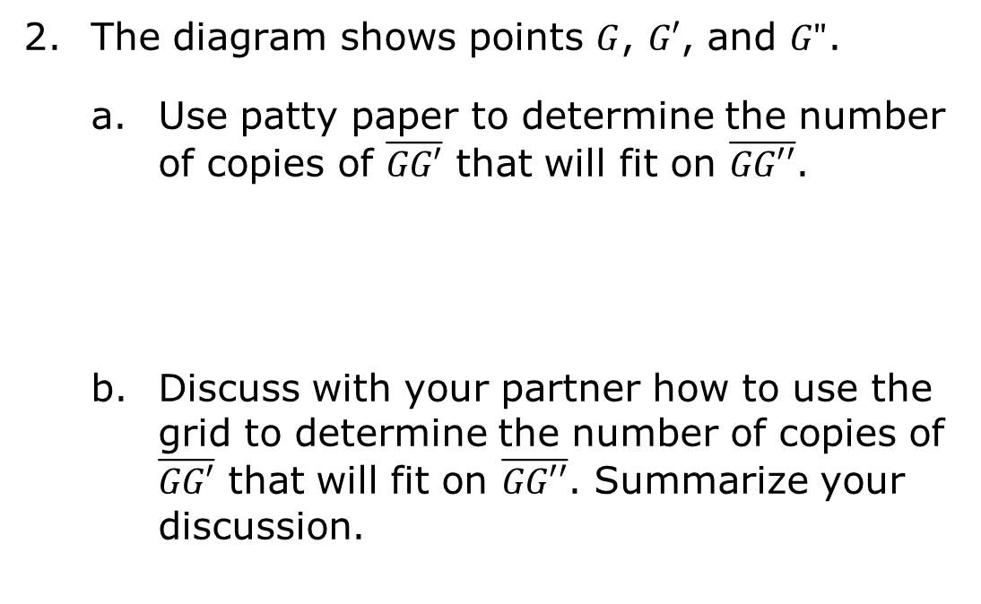
The diagram shows points $G$, $G′$, and $G"$.
Use patty paper to determine the number of copies of $\overline{GG′}$ that will fit on $\overline{GG′′}$.
Discuss with your partner how to use the grid to determine the number of copies of $\overline{GG′}$ that will fit on $\overline{GG′′}$. Summarize your discussion.
volume 1, pg. 22

Slide 12
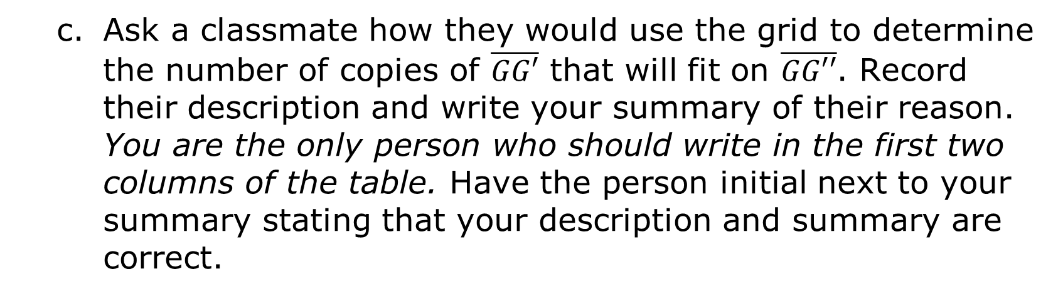
Ask a classmate how they would use the grid to determine the number of copies of $\overline{GG′}$ that will fit on $\overline{GG′′}$. Record their description and write your summary of their reason. You are the only person who should write in the first two columns of the table. Have the person initial next to your summary stating that your description and summary are correct.
Description | My Summary of Their Reason | Initials
volume 1, pg. 23

Slide 13


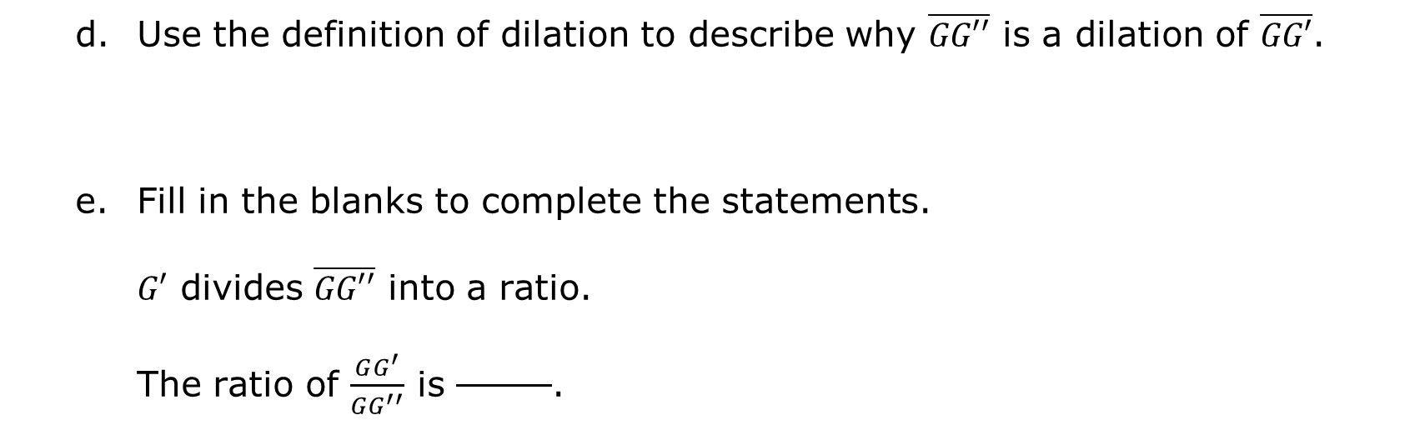
A dilation is a proportional increase or decrease in size in all directions.
Use the definition of dilation to describe why $\overline{GG′′}$ is a dilation of $\overline{GG′}$.
Fill in the blanks to complete the statements. $G′$ divides $\overline{GG′′}$ into a ratio. The ratio of $\frac{GG^{′}}{GG^{′′}}$ is .
Partition means to separate or to divide. A line segment can be partitioned into smaller segments. A ratio can be used to describe the partition.
volume 1, pg. 23

Slide 14
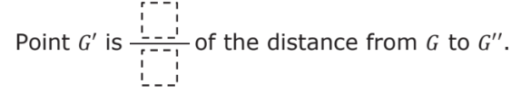

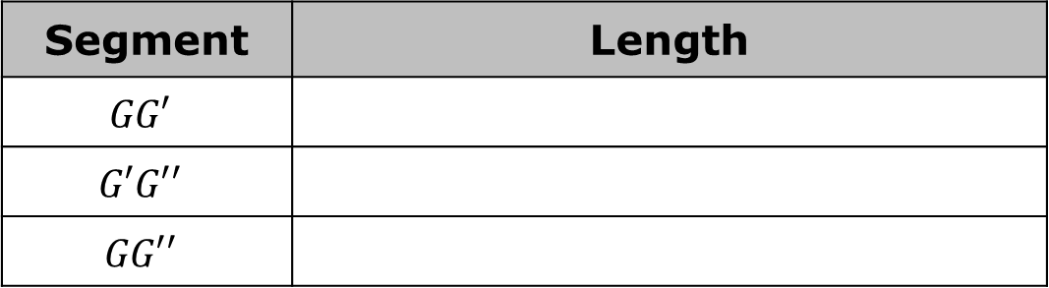

Use the Pythagorean theorem to complete the table.
Point $G′$ is of the distance from $G$ to $G′′$.
What value can be multiplied to the length of $GG′$ to determine the length of $GG′′$?
Segment | Length
$$GG′$$
$$G′G′′$$
$$GG′′$$
The scale factor is the constant that is multiplied by the length of each side of a figure to produce an image that is the same shape as the original figure.
volume 1, pg. 23

Slide 15

Guided Practice
volume 1, pg. 24

Slide 16

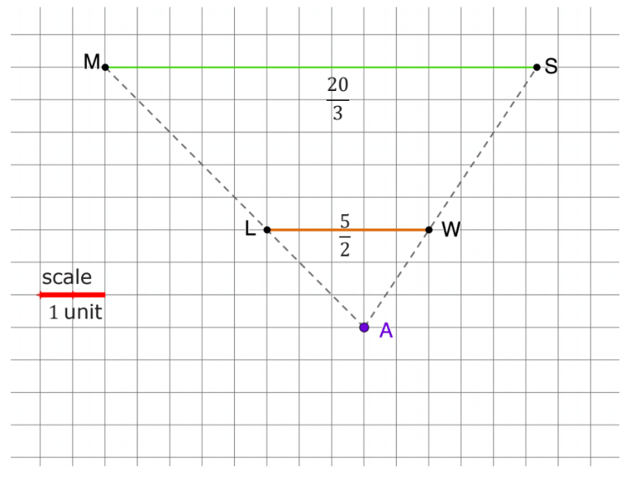
1.4.3 Guided Practice: Scale Factor
$\overline{LW}$ is dilated to create $\overline{MS}$. The center of dilation is point $A$.
volume 1, pg. 24

Slide 17
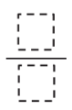
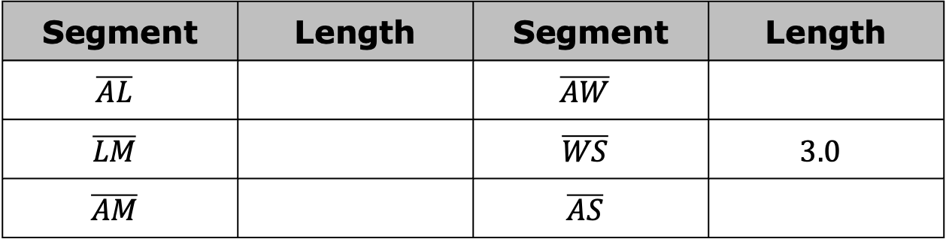
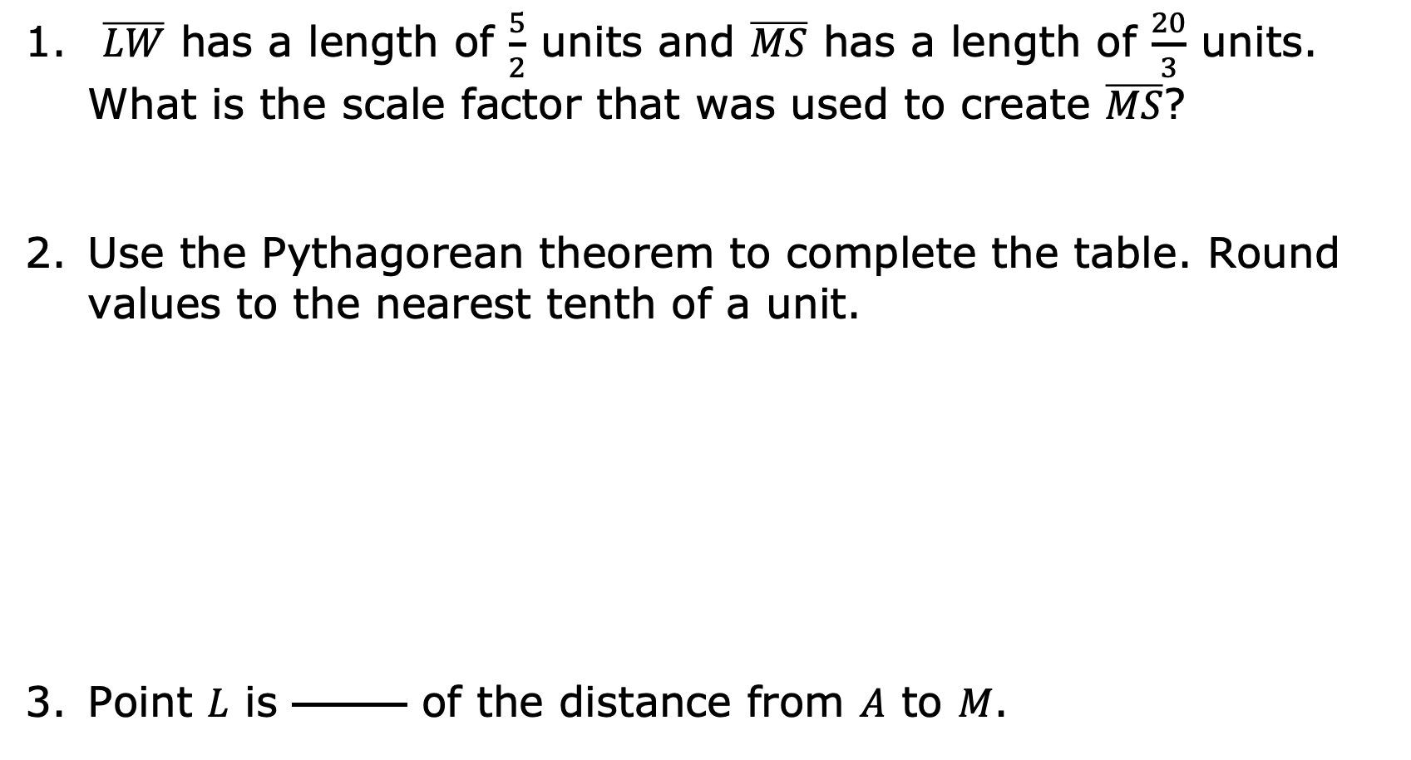
$\overline{LW}$ has a length of $\frac{5}{2}$ units and $\overline{MS}$ has a length of $\frac{20}{3}$ units. What is the scale factor that was used to create $\overline{MS}$?
Use the Pythagorean theorem to complete the table. Round values to the nearest tenth of a unit.
Point $L$ is of the distance from $A$ to $M$.
Segment | Length | Segment | Length
$$\overline{AL}$$ |  | $$\overline{AW}$$
$$\overline{LM}$$ |  | $$\overline{WS}$$ | $$3.0$$
$$\overline{AM}$$ |  | $$\overline{AS}$$
volume 1, pg. 24

Slide 18
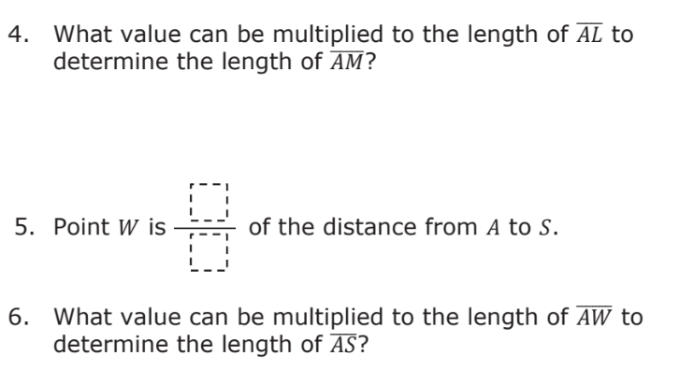
volume 1, pg. 25

Slide 19
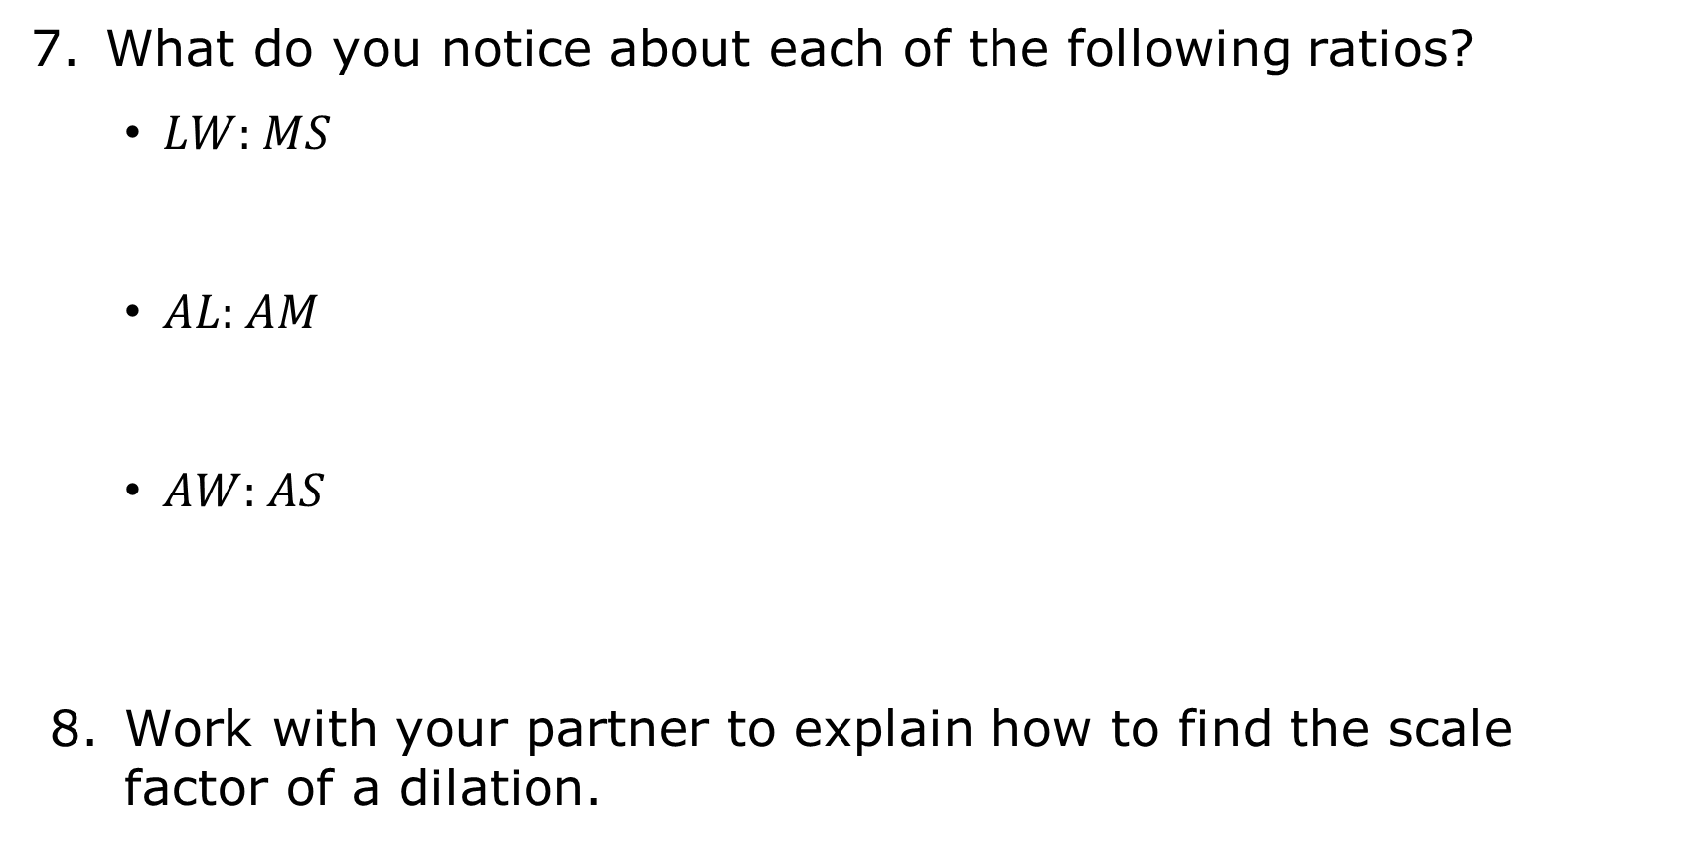
What do you notice about each of the following ratios?
$LW$:$MS$
$AL$:$AM$
$AW$:$AS$
Work with your partner to explain how to find the scale factor of a dilation.
volume 1, pg. 25

Slide 20

Bring It Together
volume 1, pg. 26

Slide 21

1.4.4 Bring It Together: Determining Scale Factor
As the class shares strategies for finding scale factor, choose a strategy other than yours to describe.
Strategy | I Liked the Strategy Because…
volume 1, pg. 26

Slide 22

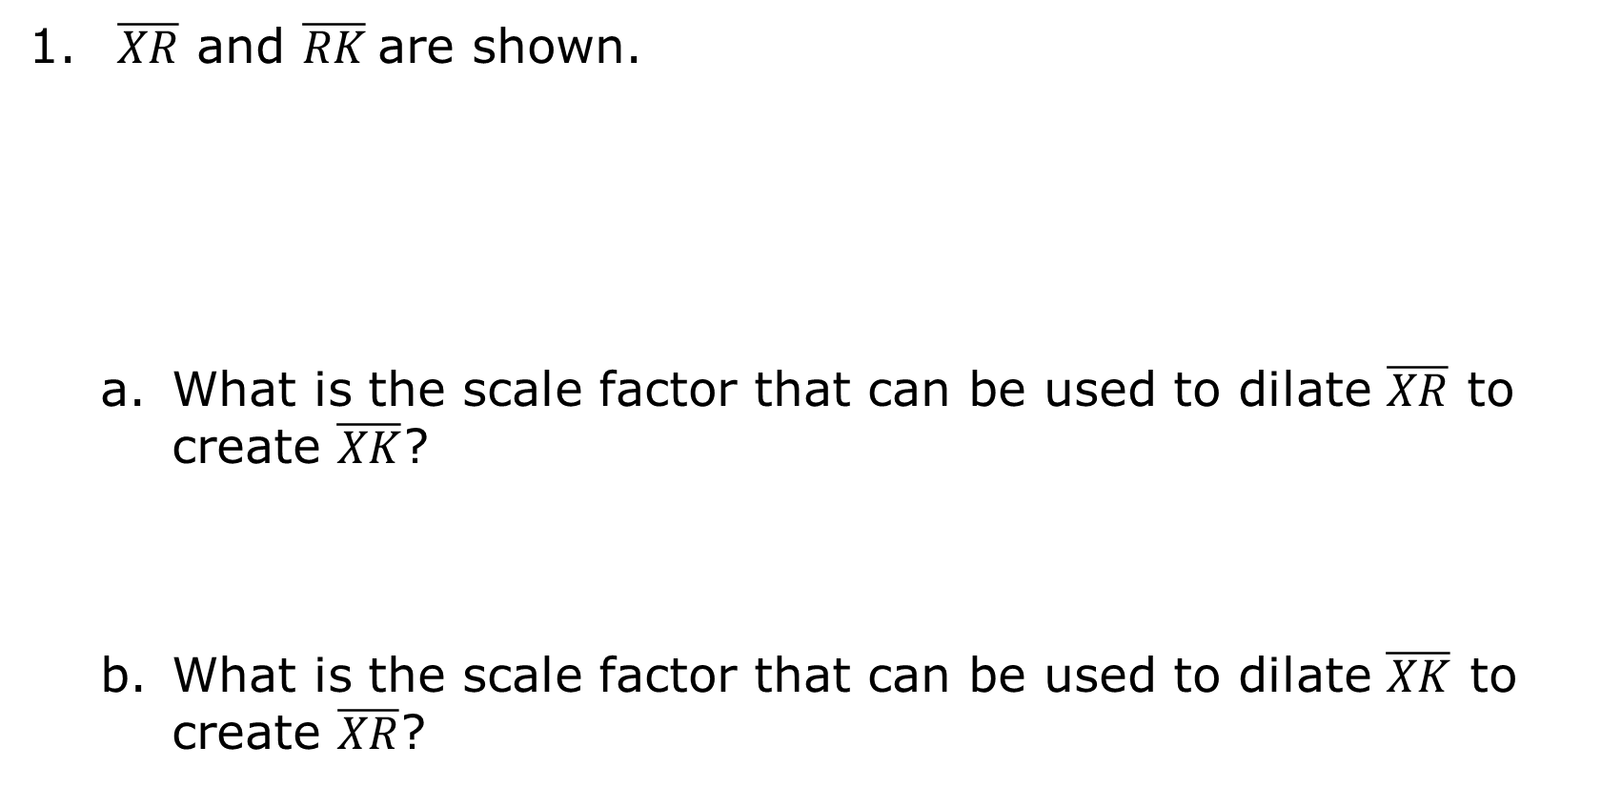
$\overline{XR}$ and $\overline{RK}$are shown.
What is the scale factor that can be used to dilate $\overline{XR}$ to create $\overline{XK}$?
What is the scale factor that can be used to dilate $\overline{XK}$ to create $\overline{XR}$?
volume 1, pg. 26

Slide 23
Describe point $R$ in relation to $\overline{XK}$.
The midpoint of a line segment is the point that divides a line segment into two equal segments.
volume 1, pg. 26

Slide 24

Wrap-Up
volume 1, pg. 27

Slide 25
1.4.5 Wrap-Up: Cool Down
Isometry is a transformation that preserves distance and angle measure. Write a short note that describes whether a dilation preserves distance or not.
volume 1, pg. 27

